Slide 1


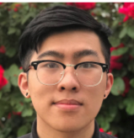



SDP21 MDR
Team 31
Mail Gobbler 9000 (MG9K)
Team 31: Brendan Truong, Adam Cytrynowski. Luan Vo, Jackie Chan ; 16 November 2020
Notes:
Jackie

Slide 2
Individual Roles and Presentation Overview
Brendan Truong
Team Leader and Backend Developer
Jackie Chan
Budget Management and Front-end Developer
Luan Vo
Hardware and Circuit Designer
Adam Cytrynowski
Communication Specialist and Box/Website Designer
Notes:
Luan

Slide 3
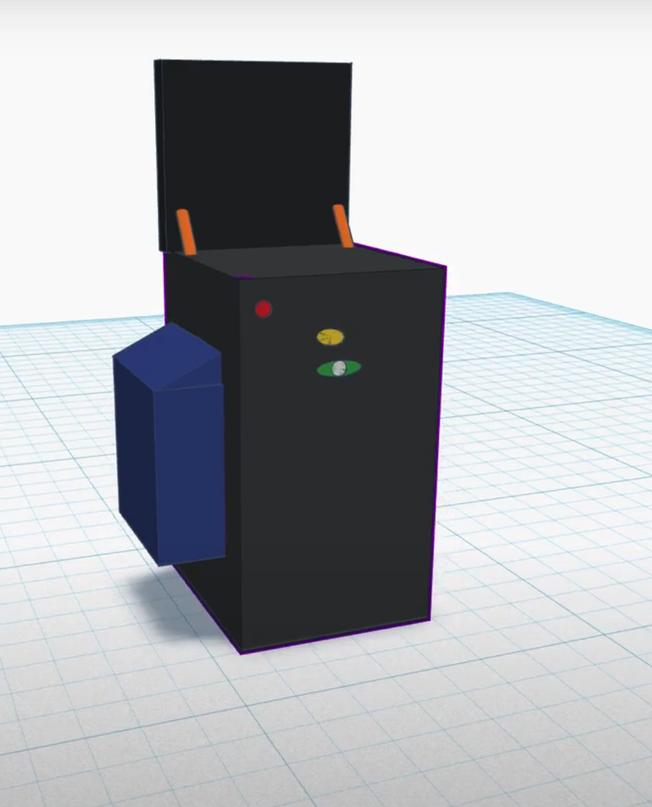
Product Statement and Specifications
Mail Gobbler 9000 (MG9K)
Smart drop-box for postal security
Barcode Authorization
Quality of Life
Delivery notifications
Multiple unlocking mechanisms
Historic logs
Power-efficient & low cost
Notes:
Jackie

Slide 4
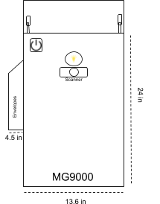
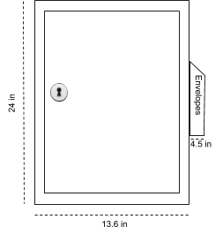

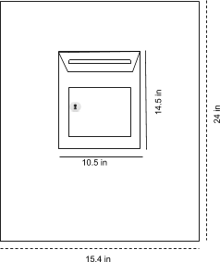
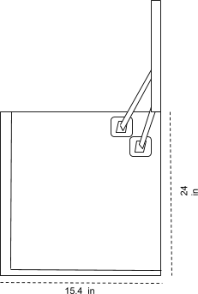
Product Statement and Specifications
Notes:
Source; fits 98% of packages: https://news.theinventory.com/yes-eufy-is-making-a-smart-mailbox-now-1844840737
https://files.slack.com/files-pri/T012492VCNT-F01FF4MH1V2/image.png

Slide 5
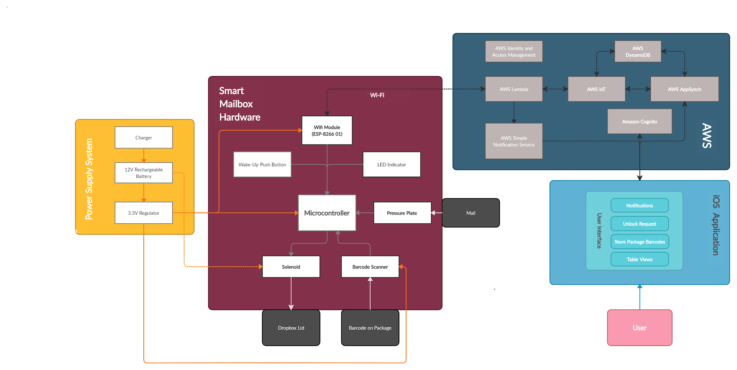
System Block Diagram
UPDATED
Notes:
Adam

Slide 6
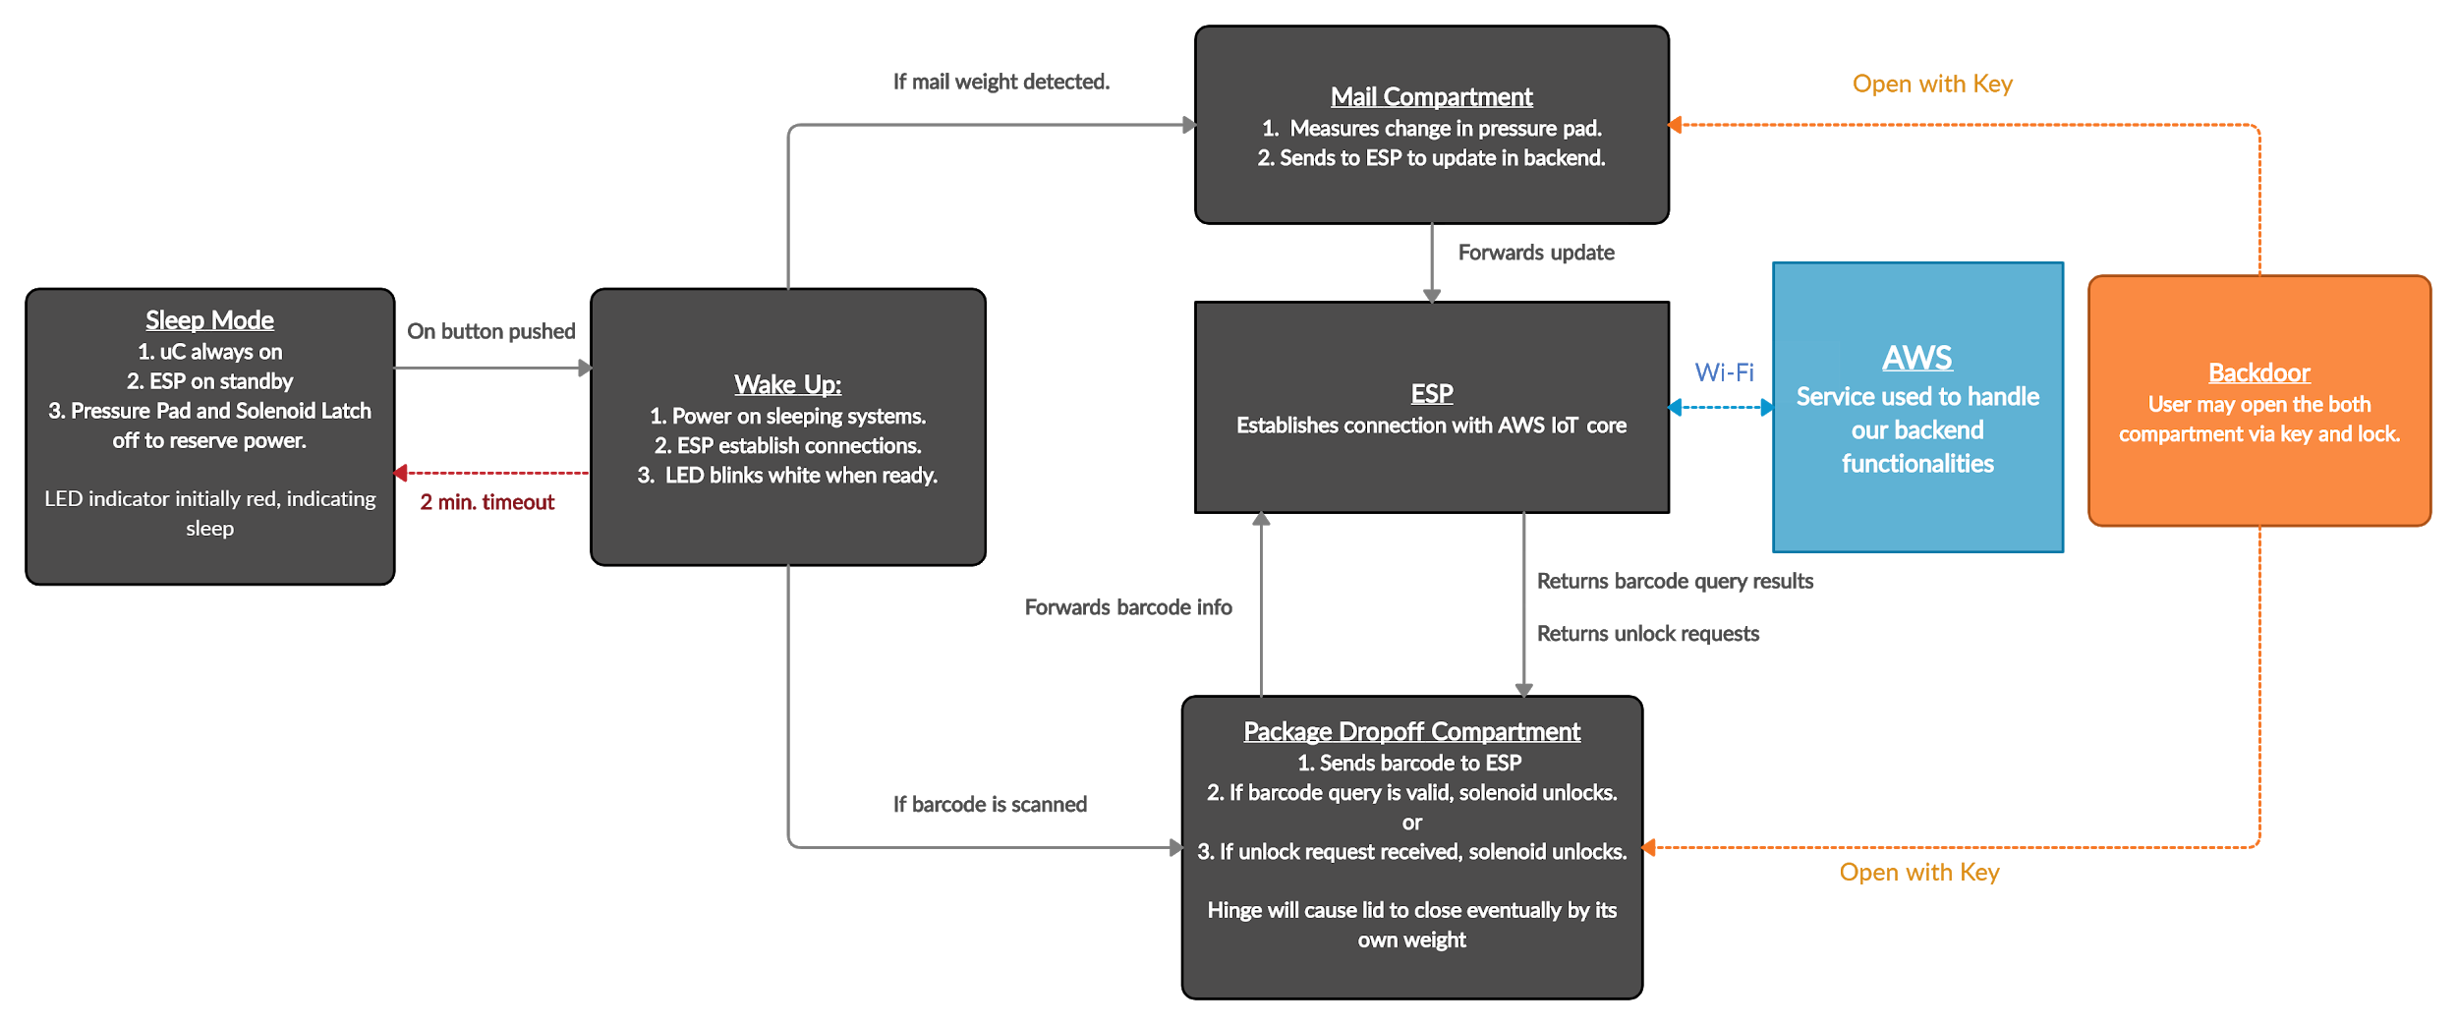
Hardware Functionality Block Diagram
UPDATED
UPDATED
Notes:
Luan

Slide 7
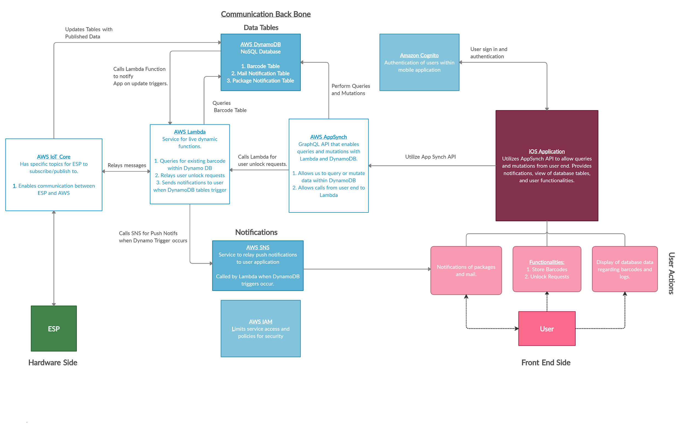
Software Functionality Block Diagram
UPDATED
UPDATED
Notes:
Brendan

Slide 8
MDR Accomplishments Overview
Set up subsystem’s various hardware functionalities.
Program ESP for data reception and communication.
Develop AWS Backend for cloud computation and data storage.
Code Mobile Application for user interaction
Success in each subsystem allowed complete end to end communication, from ESP through the backend to the Mobile Application.
Notes:
Brendan

Slide 9
Brendan’s Subsystem (Backend AWS)
Detailed Responsibilities
In charge of communication between the team and faculty, monitoring the team’s progress, and keeping the team on track and productive.
In charge of developing system’s backend with AWS, and ensuring full end to end connection.
Subsystem entails the AWS backend functionality for the project, which encompasses services for data storage, manipulation and cloud computing. Main services are as follows:
AWS IoT Core
Set up “Thing” in AWS with proper policies and rules for specific topics.
AWS Lambda
Coded dynamic javaScript functions to communicate with IoT Core and manipulate tables.
AWS DynamoDB
Created three essential tables to hold data. Includes barcodes, package logs, and mailing logs.
AWS AppSynch
Designed and programmed a GraphQL API for queries and mutations.
Notes:
Brendan

Slide 10
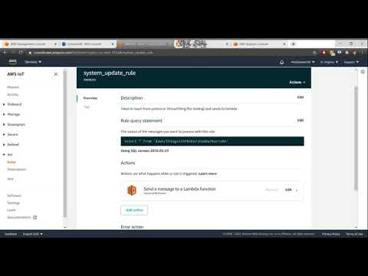
Brendan’s Portion (Backend AWS)
Notes:
Brendan

Slide 11
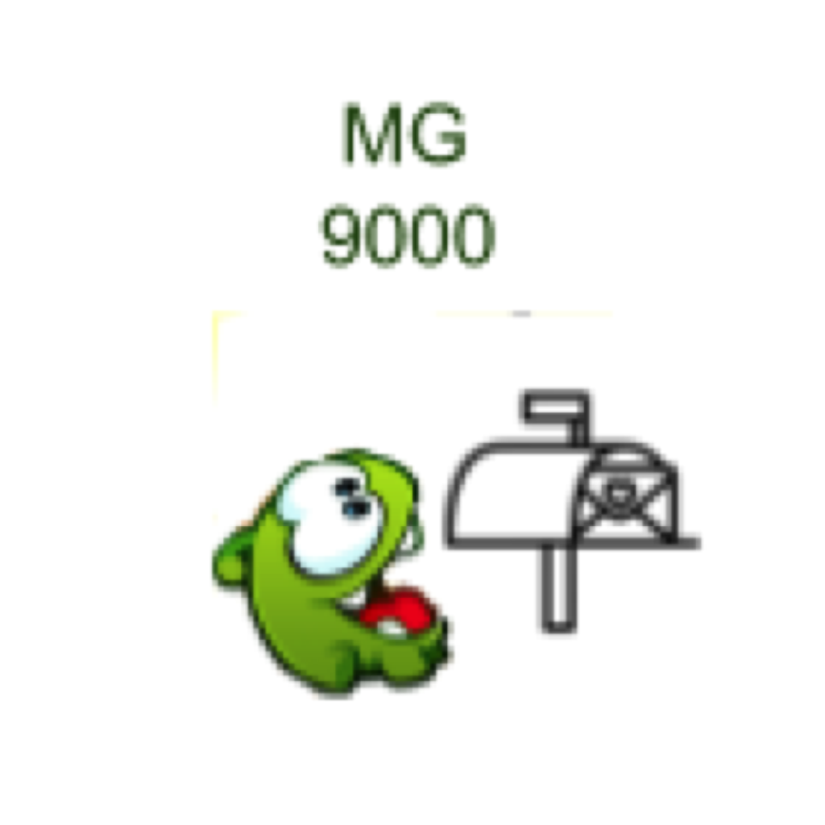
Jackie’s Subsystem (Front End Application)
Detailed responsibilities:
Front-end developing of an application that allows the user to upload barcode, send unlock request, receive historic logs.
Ensuring team’s expenses do not exceed allocated budget and serving as liaison between the team and purchasing coordinators.
App Creation:
xCode
IDE created by Apple for the development of iOS Apps.
Google Drawing
Allows for the use of shapes to create charts and diagrams.
Github
Hosting service that offers source code management.
Notes:
Jackie
https://github.com/MailGobbler9000

Slide 12
Jackie’s Portion (Front End App)
Notes:
Jackie

Slide 13
Adam’s Responsibility (Hardware Communication)
Detailed responsibilities: In charge of ensuring the smooth communication between ESP and AWS IoT. Brainstorming mailbox’s mechanic for the actual production phase, and oversees the functionality of the mailbox, and scanner's physical interactions with its surroundings. Assists in website development
Demo Showcases:
MCR12 Barcode Scanner - Scanner Functionality
ESP to Backend Interaction - MQTT communication with AWS

Slide 14
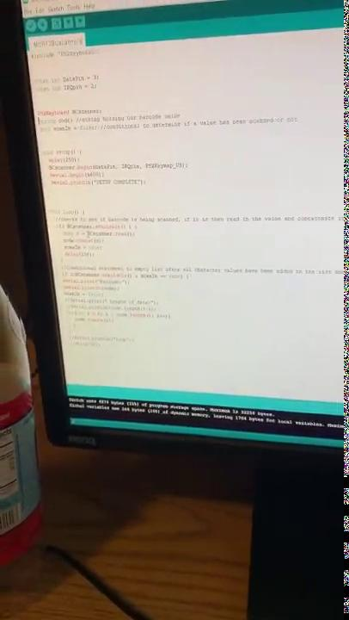
Adam’s Subsystem (Hardware Portion 2)
Notes:
Adam

Slide 15
Adam’s Subsystem (Hardware Portion 2) contd.

Slide 16
Luan’s Subsystem (Hardware Mechanics and Behaviors)
Detailed responsibilities: Design circuit foundation and proposes hardware components that will be used to meet the required specifications listed by the team.
My subsystems consist of the followings:
Power button (push button) - Waking the system up from initial stage, during wake up mode, output HIGH voltage on all required pins.
Force Sensing Resistor (mail compartment trigger) - Detects incoming mail via a change in resistance of the pressure pad.
Switching Solenoid (package compartment locking mechanism) - lock the box during initial stage (off mode) and unlock the box once the box wakes up (on mode).
Dc/Dc converter - converting 12VDC into 3.3VDC
Notes:
Luan

Slide 17
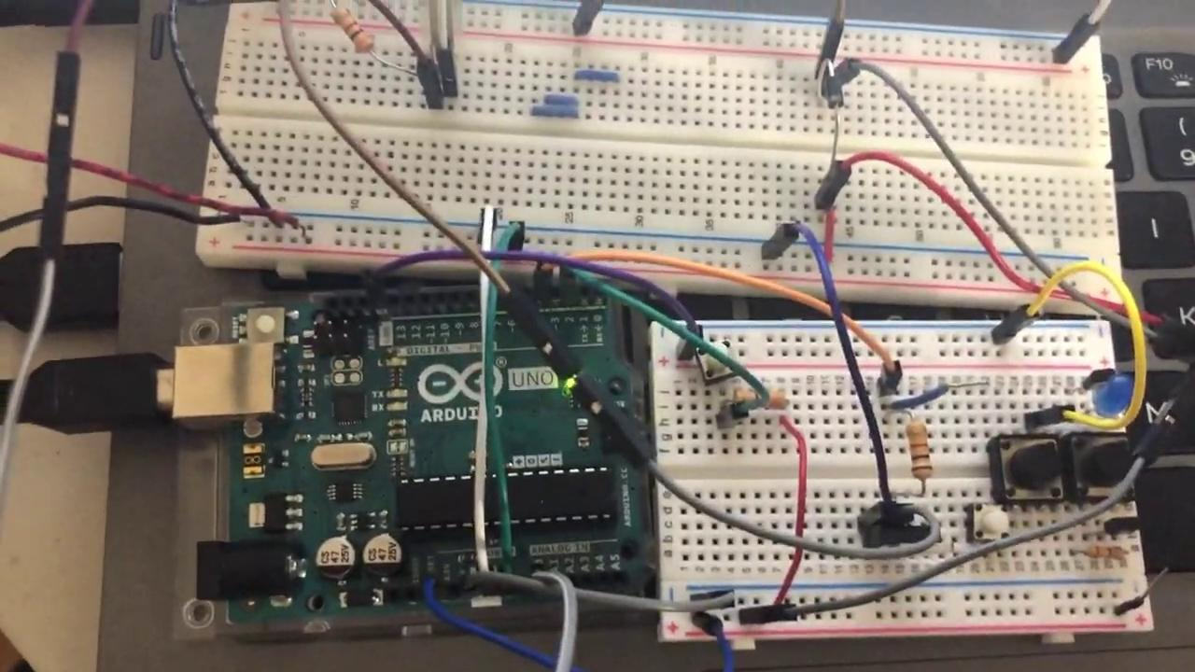
Luan’s Subsystem (Hardware Demo Push Button)
Notes:
Luan

Slide 18
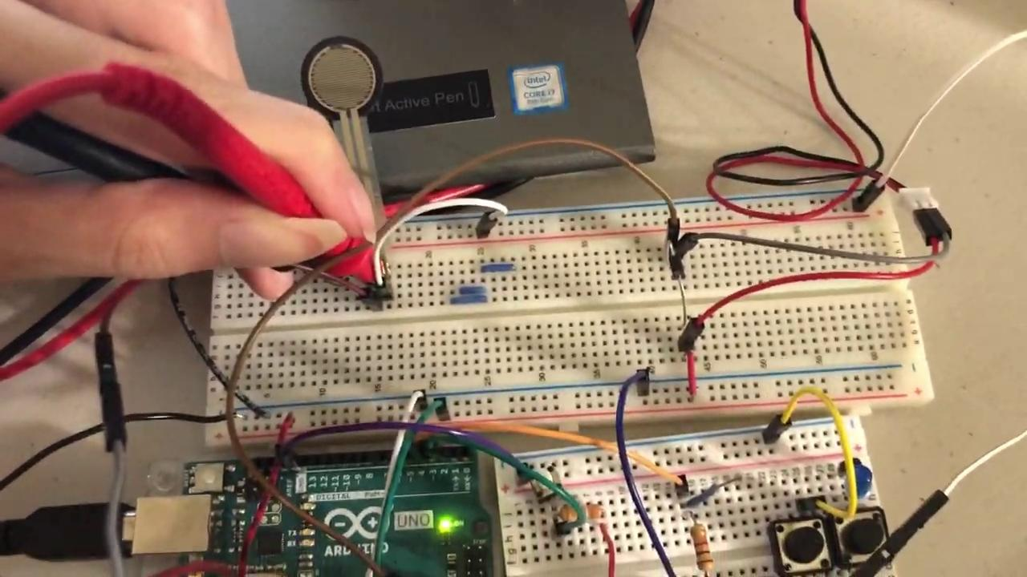
Luan’s Subsystem (Hardware demo FSR)
Notes:
Luan

Slide 19
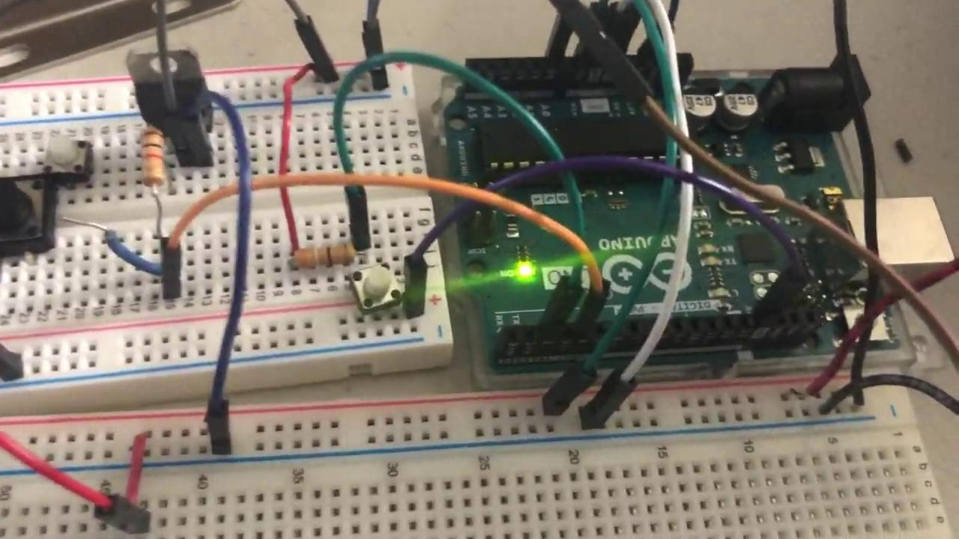
Luan’s Subsystem (Hardware demo Solenoid)
Notes:
Luan

Slide 20
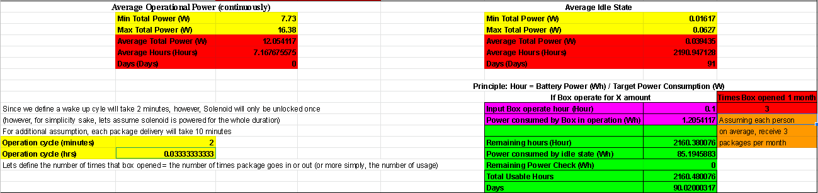
Luan’s Subsystem (Power Specification)
Full spreadsheet:
https://docs.google.com/spreadsheets/d/1X-PXSN7Y21ZjLVsWlBEaUqzN06b_FOBv/edit#gid=2117688693
Notes:
Luan

Slide 21
Hardware/Software List
Current
Future
Hardware Modules:
ESP8266
MCR12 Barcode Scanner
12 - V Solenoid
ATMega328P
Pressure Plate
Backend Modules
AWS (Amazon Web Services)
IoT Core
Lambda
AppSynch
DynamoDB
EC2
Cognito
Website Modules: 1. HTML and CSS
2. Github Pages
Hardware Modules:
Atmel Studio
PCB
Buck Converter
Wii Fit Board Sensor / Ultrasonic Sensor
Front-End Modules
xCode
Google Drawing
Github
Notes:
Adam

Slide 22
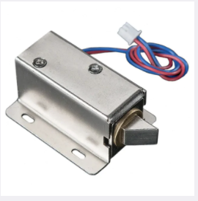
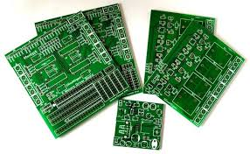
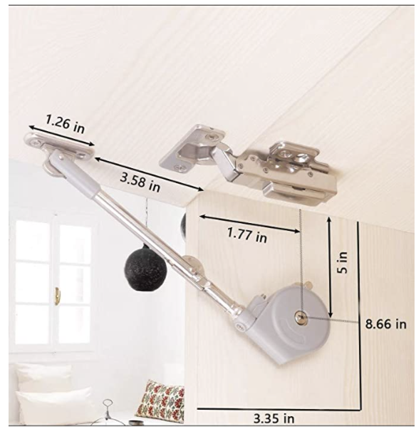
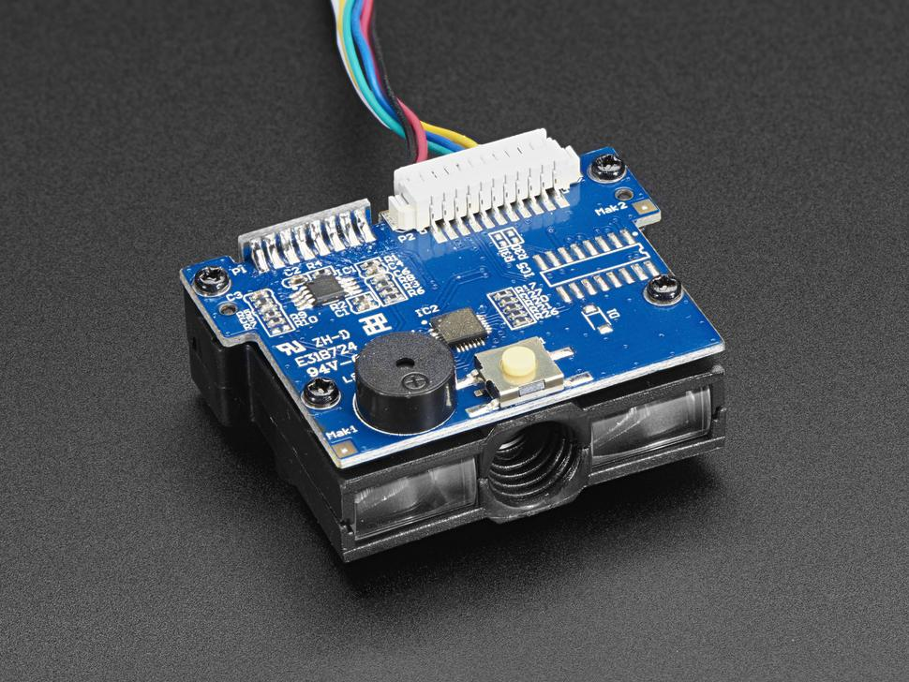
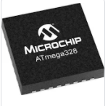
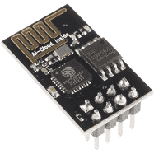
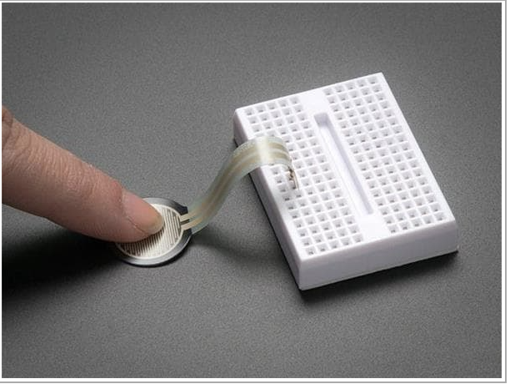
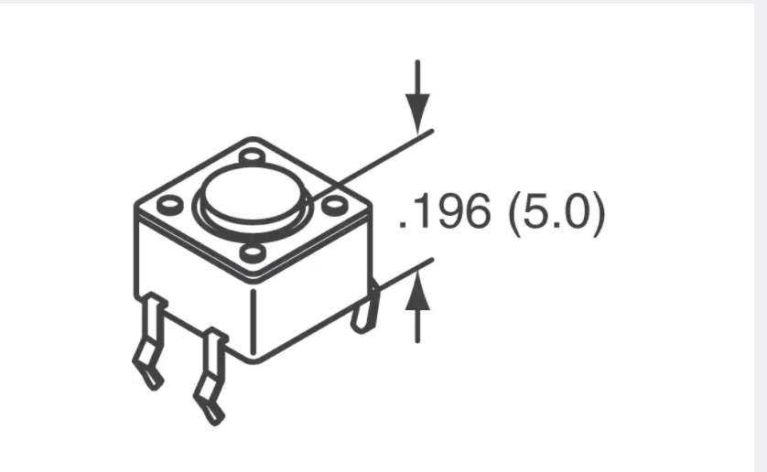
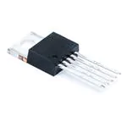

Hardware Plans for FPR - 1 Hardware Components
PCB
Atmega328P
Vocomo Lid Support Hinge
MCR12 Barcode Reader/Scanner Module
Solenoid Pull 1512
ESP8266 Wifi Module
Pressure Sensor Development Tool
Tactile “Wake up” Switch
3.3V Buck Converter
12V 7.2Ah battery
Notes:
Adam

Slide 23
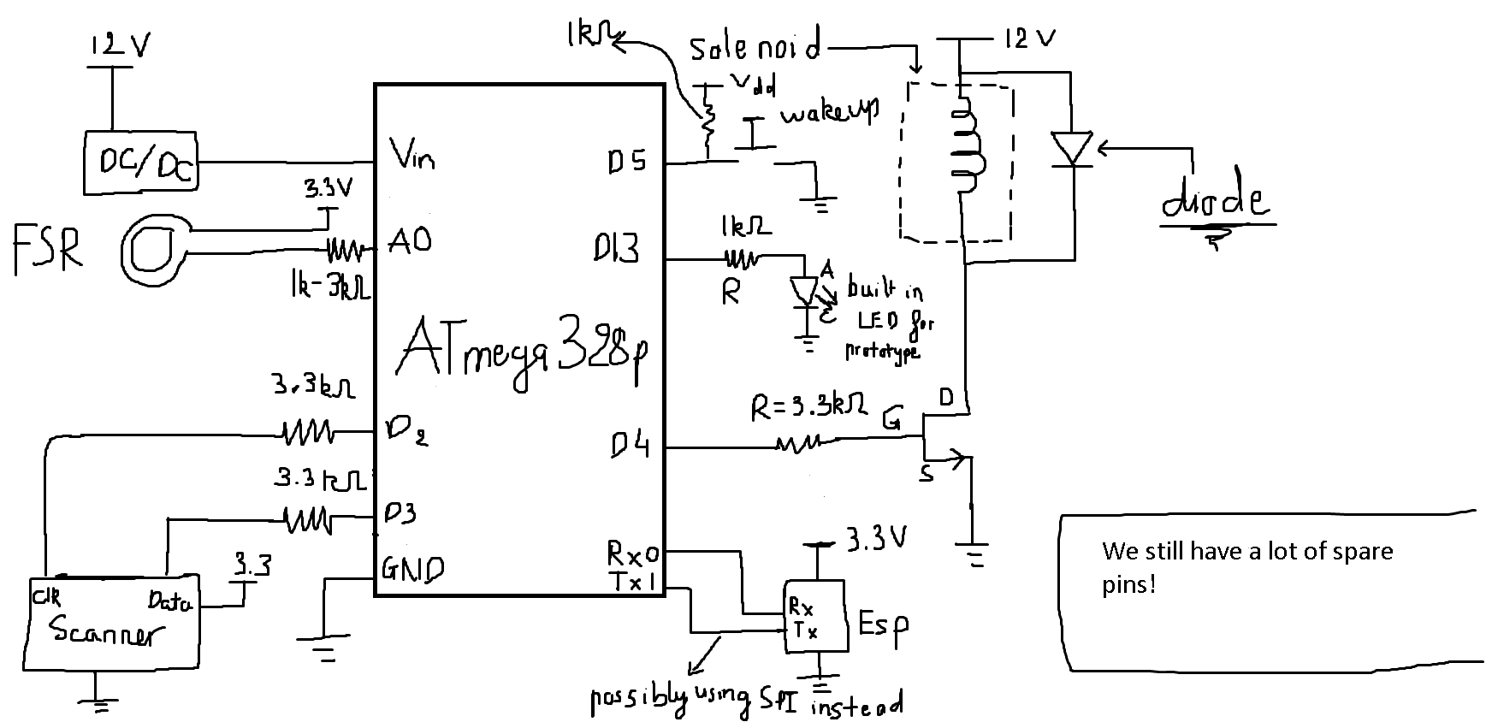
Hardware Plans for FPR - 2 Design Schematic
Notes:
Luan

Slide 24
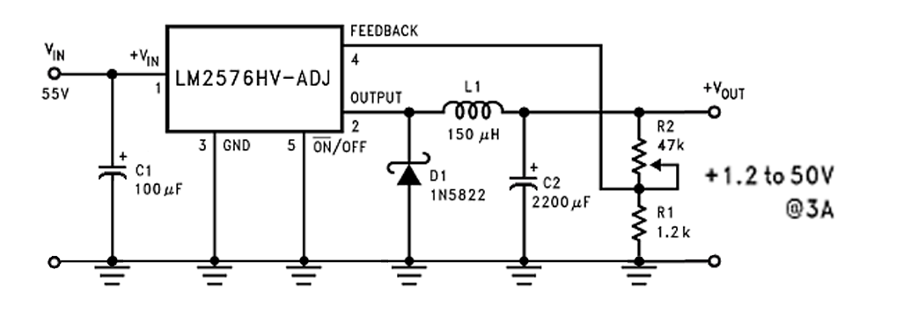
Hardware Plans for FPR - 3 DC/DC converter
Notes:
Luan

Slide 25
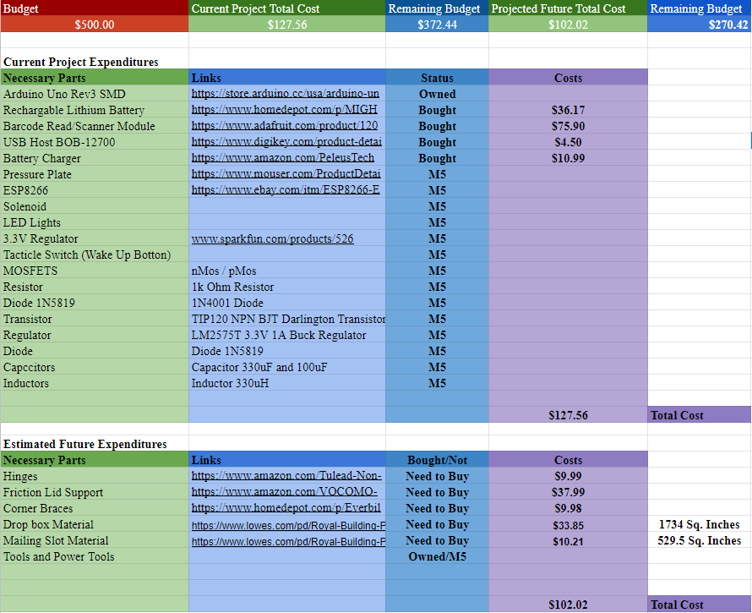
Project Expenditures
Notes:
Jackie
https://docs.google.com/spreadsheets/d/1SulvPZXw-SxbTrpIn-wtB6Wj_H4eWrKV_0V_pc1IldE/edit#gid=0

Slide 26
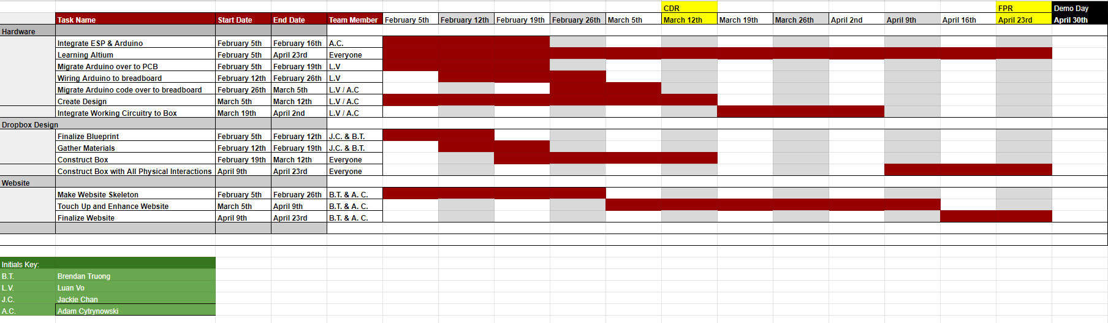
Gantt Chart
Notes:
Brendan

Slide 27
Thank You!
and
Questions?
Notes:
Jackie

Slide 28

Notes:
Jackie

